Slide 1


Stellar tracers of the thin Disk component
Maria Messineo

Slide 2
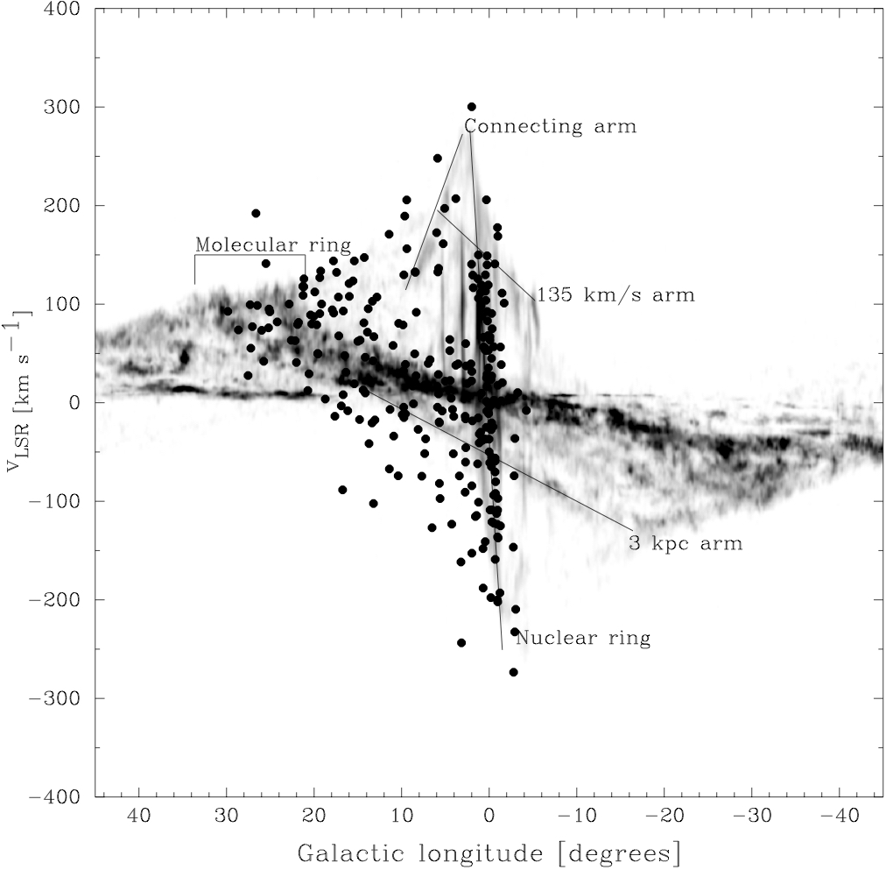

86GHz SiO masing Late-tape stars in the inner Galaxy
PhD thesis
Supervisor Habing, H.
A&A, 393,115-128,2002

Slide 3
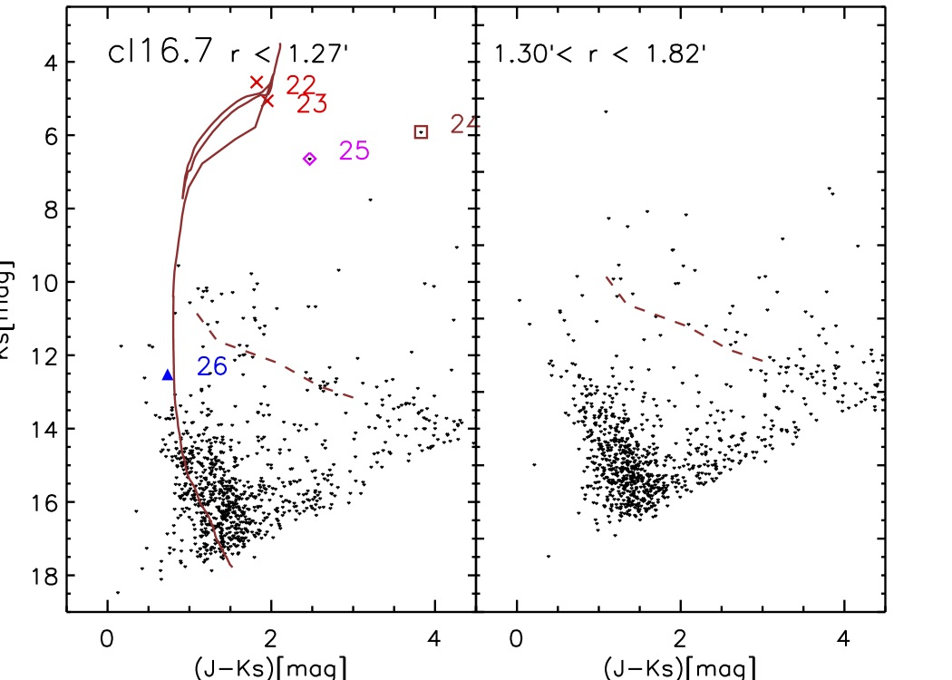
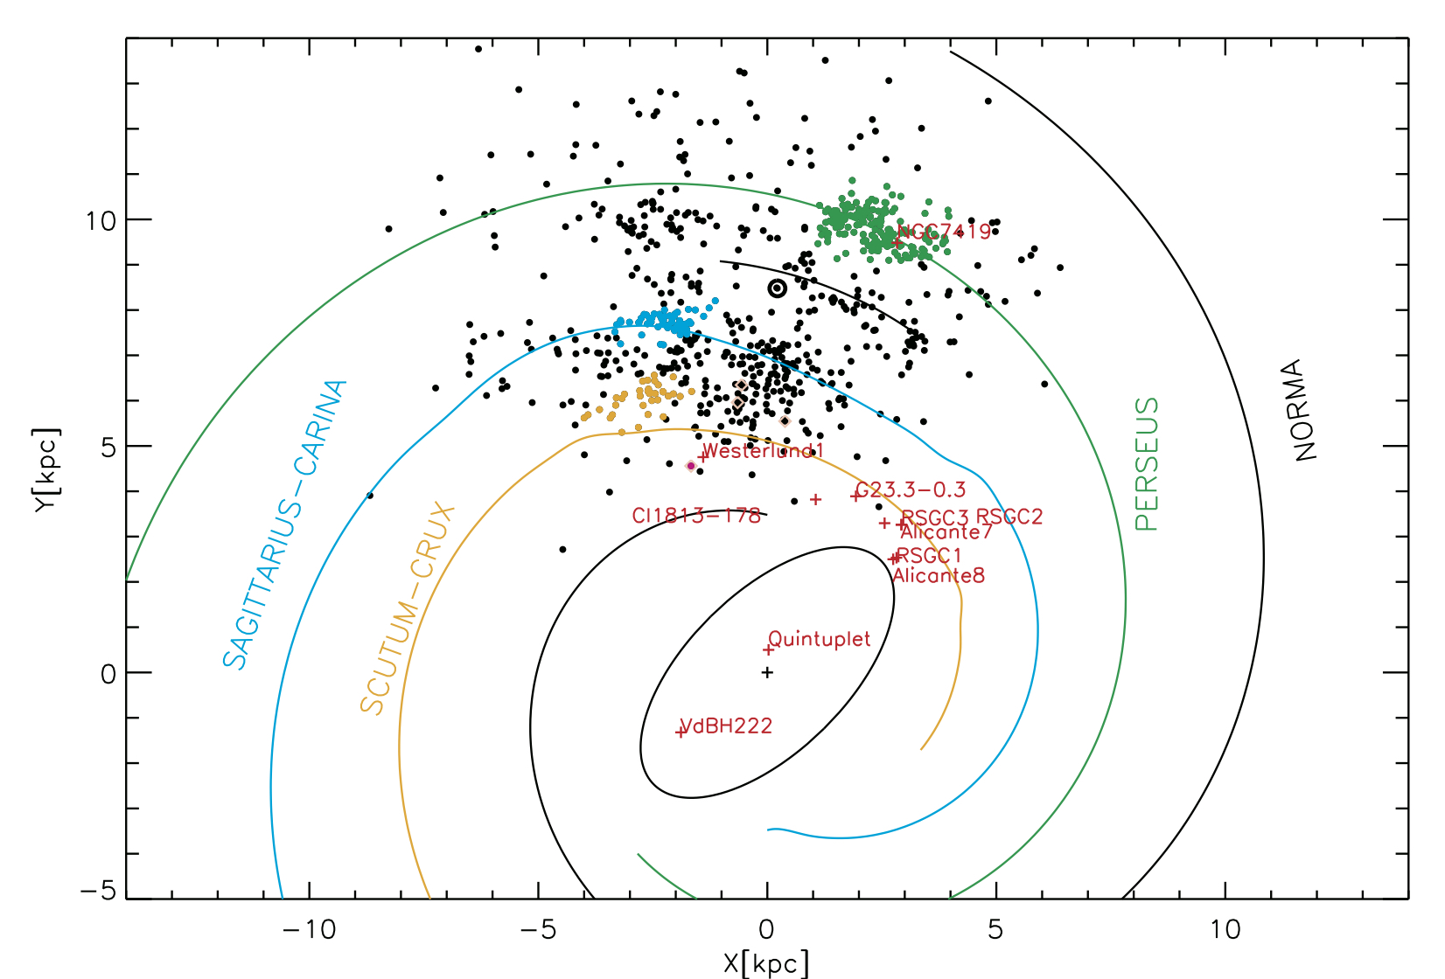
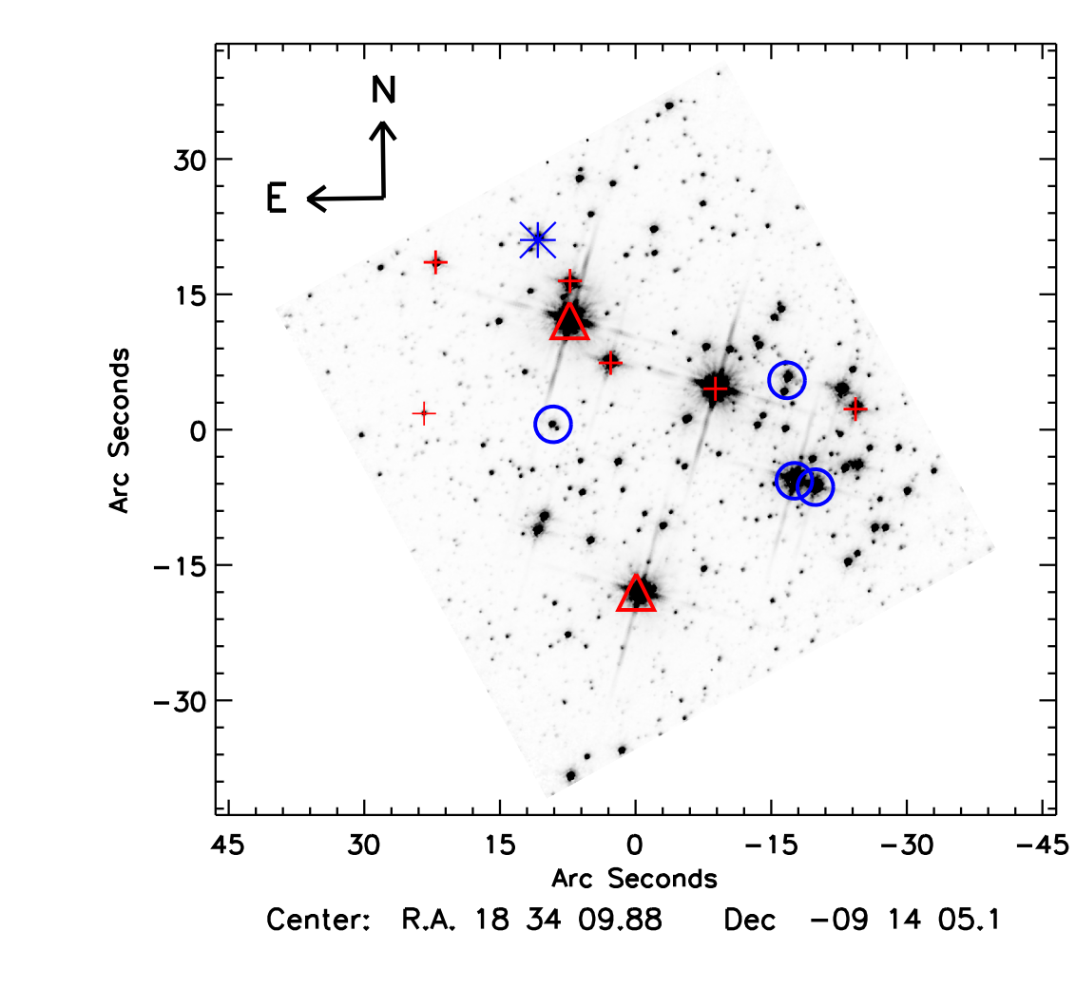
Candidate red supergiants
only 18% are members
A&A, 571, A43 (2014)
A&A, 698, 282, 2025
ApJ 708, 1241, 2010

Slide 4
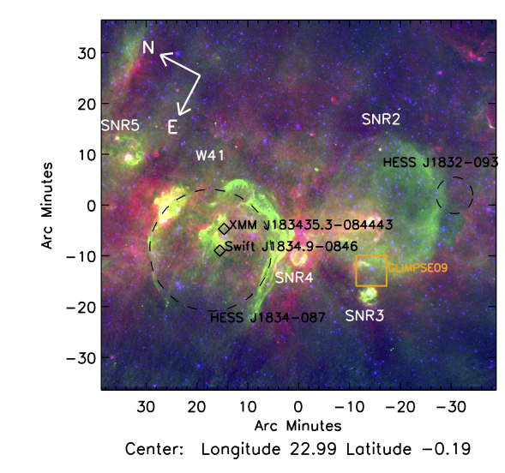
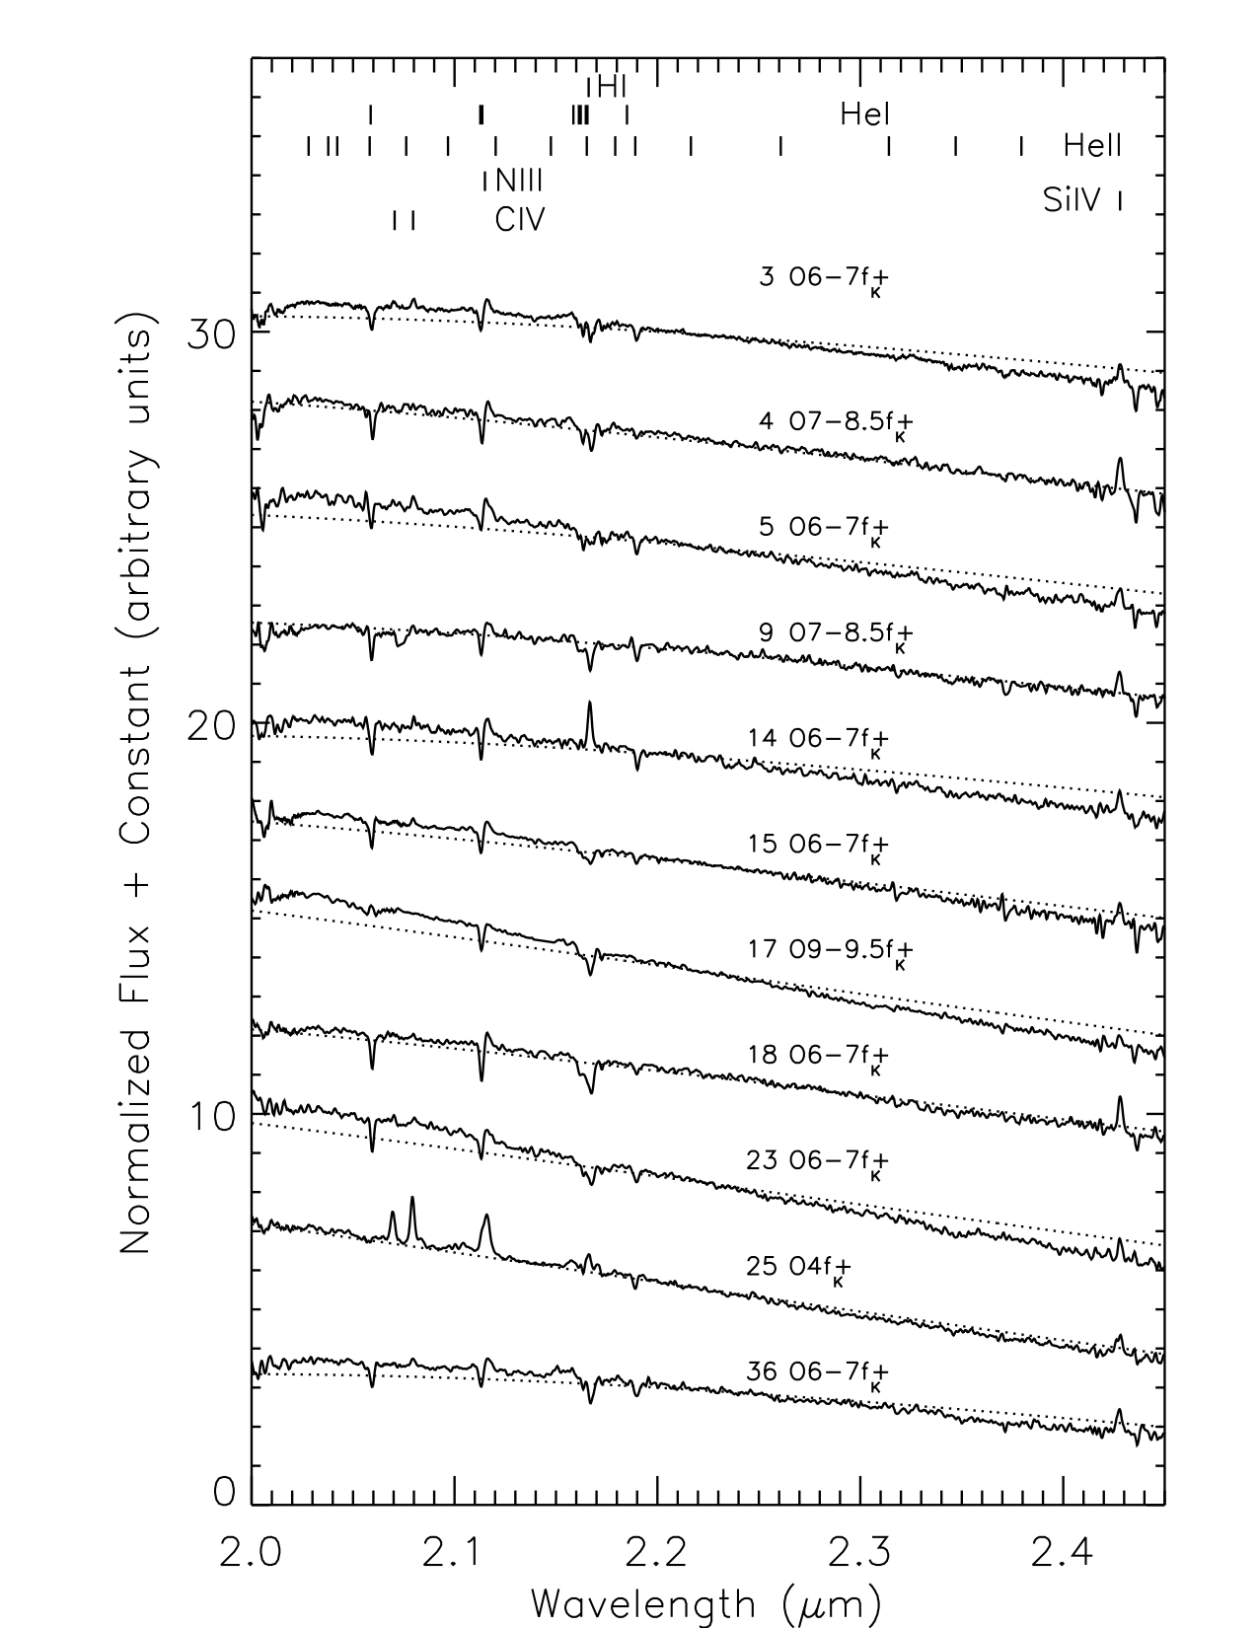
The G23.3-0.3 giant molecular complex
Blue = 3.6 um
GLIMPSE
Green = 20 cm
MAGPIS
Red = 8 um
GLIMPSE
SNRs from:
Green 1991
Helfand et al. 2006
2=G22.7-0.2
3=G22.7583-0.4917
4=G22.9917-0.3583
5=G23.5667-0.0333
High-energy
Aharonian et al. 2005
Laffon et al. 2011
Mukherjee et al. 2009
Kargaltsev et al. 2012
A&A, 569, A20, 2014

Slide 5
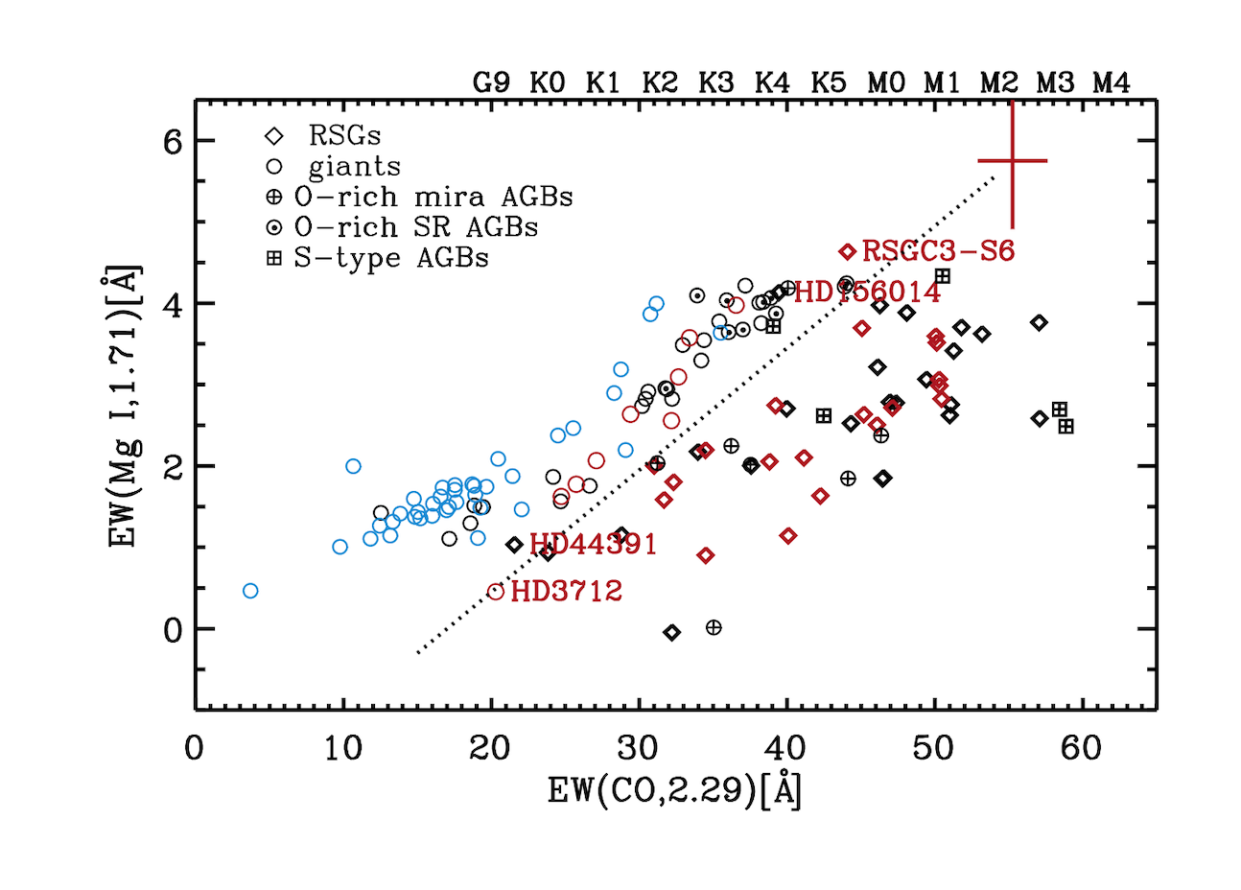
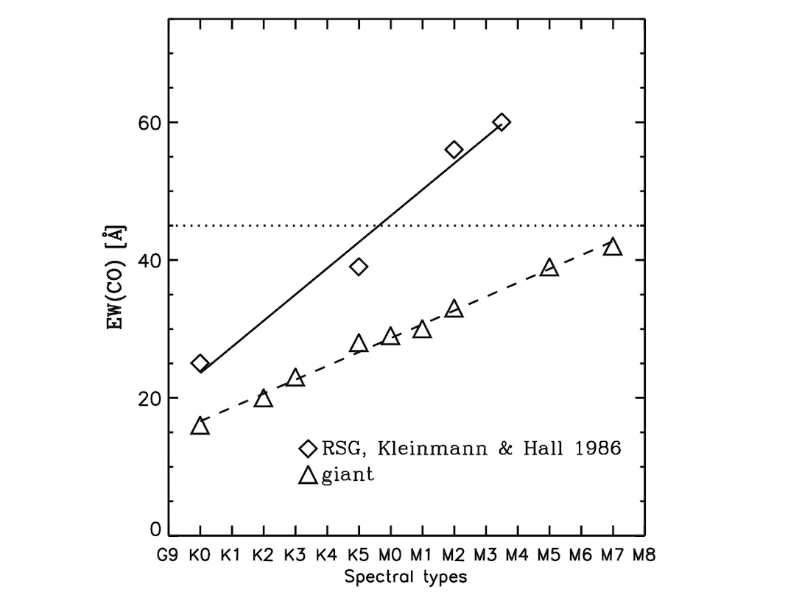
Separating giants and red supergiants
Messineo M., Figer D.F., Kudritzki R.-P., Zhu Q., Menten K. M., Ivanov V.D., & Chen C.-H. R. 2021, AJ, 162, 187
Messineo, Zhu, Menten, Ivanov, Figer,
Kudritzki, Chen ApJ, 822, L5, 2016
Notes:
For stars above the red giant branch, the GSP-Phot Teff values are compared with those adopted in Messineo & Brown (2019).
For 82 stars with low gravity below 0.5, there is a good agreement between the two temperatures with a mean delta of 105 and a standard deviation of 82K.
These are mostly M-type located at extinction Av < 2mag.
With increasing extinction (distance) stellar Teff values may appear higher.
An overestimated extinction yields a warmer temperature.
There is a mean shift 0f -0.05 and a sigma=0.36 for the gravity differences.
For the metallicity, only a few values are available in literature and the sigma=0.25 dex.

Slide 6
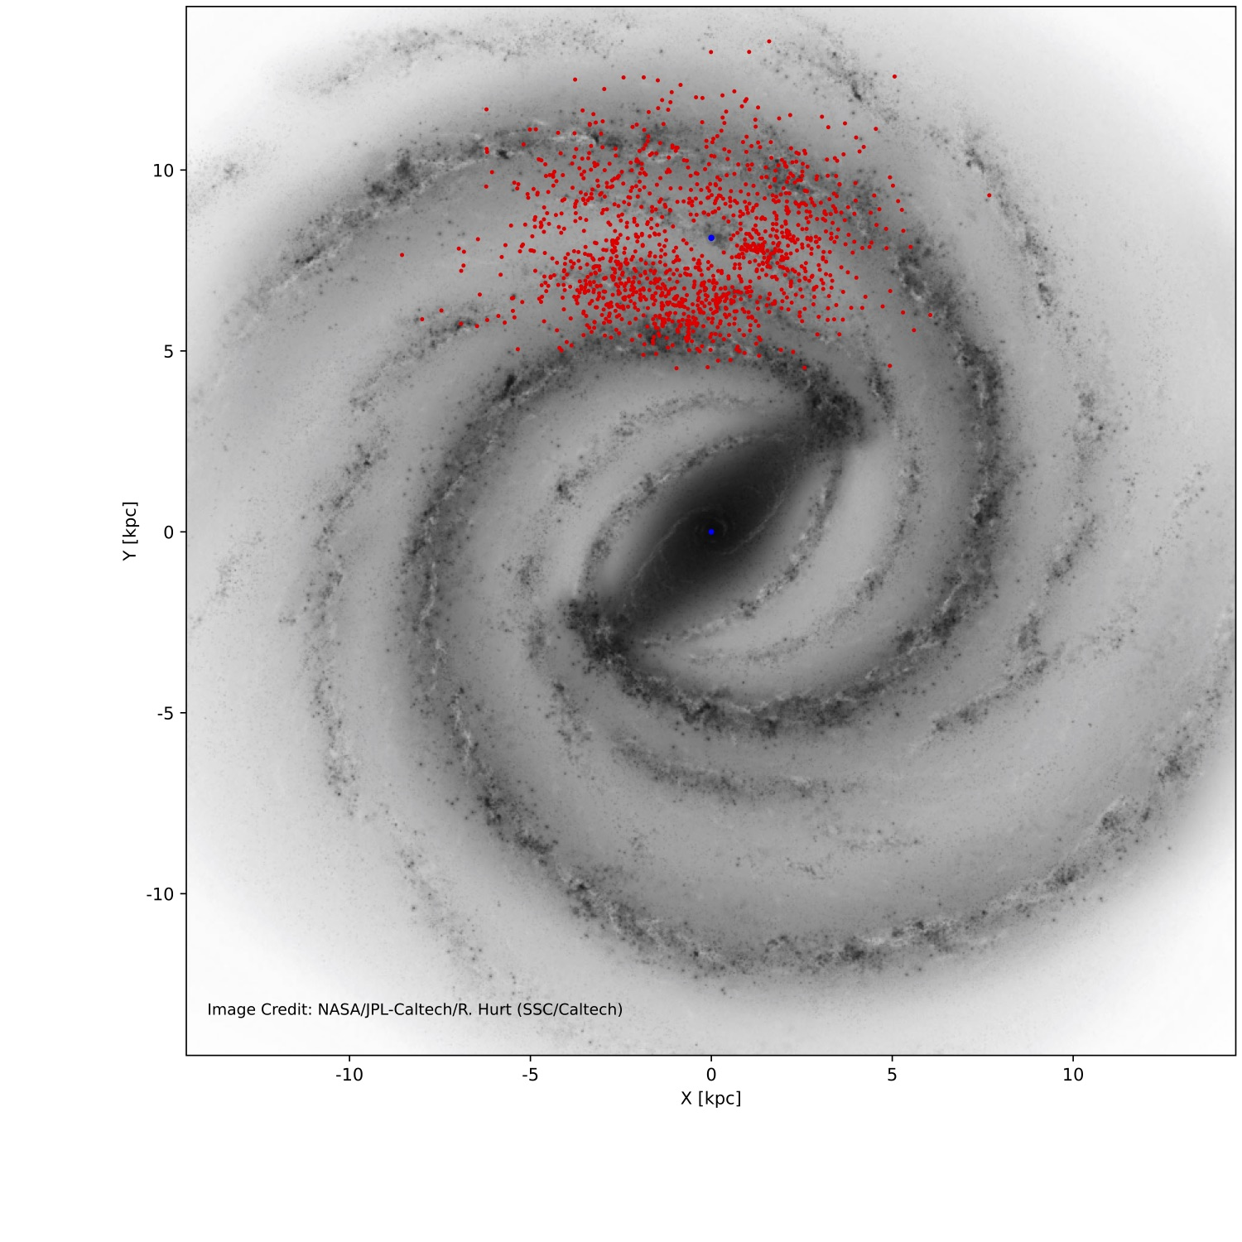
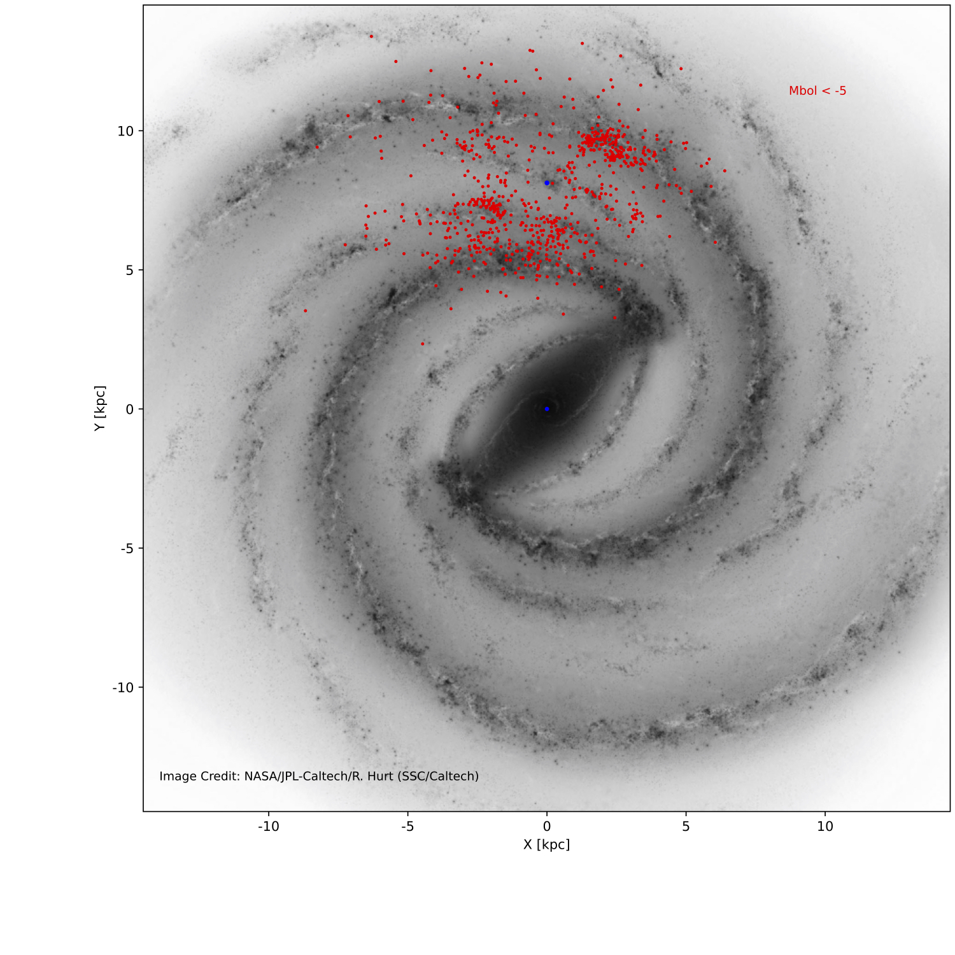
Candidate red supergiants from Gaia DR3
cRSGs
Red giants/ AGBs
A&A, 698, 282, 2025

Slide 7
Gaia-DR3 APIS parameters of RSGs:
Based on 500 known RSGs from the catalog of Messineo & Brown (2019) -- areas A & B
Notes:
For stars above the red giant branch, the GSP-Phot Teff values are compared with those adopted in Messineo & Brown (2019).
For 82 stars with low gravity below 0.5, there is a good agreement between the two temperatures with a mean delta of 105 and a standard deviation of 82K.
These are mostly M-type located at extinction Av < 2mag.
With increasing extinction (distance) stellar Teff values may appear higher.
An overestimated extinction yields a warmer temperature.
There is a mean shift 0f -0.05 and a sigma=0.36 for the gravity differences.
For the metallicity, only a few values are available in literature and the sigma=0.25 dex.

Slide 8
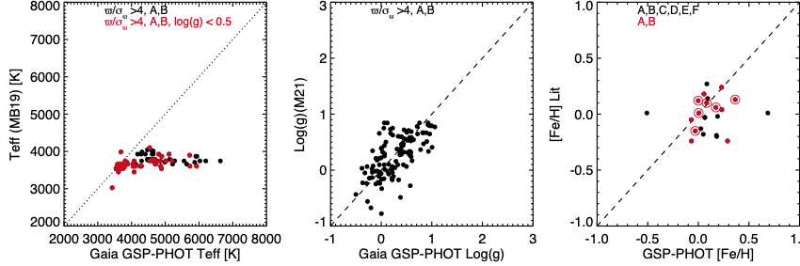
Gaia-DR3 APIS parameters of RSGs: FAILURE for K I stars temperatures
Stars are from the catalog of Messineo M., Brown, A. G. A. 2019, Messineo (2023)
Notes:
For stars above the red giant branch, the GSP-Phot Teff values are compared with those adopted in Messineo & Brown (2019).
For 82 stars with low gravity below 0.5, there is a good agreement between the two temperatures with a mean delta of 105 and a standard deviation of 82K.
These are mostly M-type located at extinction Av < 2mag.
With increasing extinction (distance) stellar Teff values may appear higher.
An overestimated extinction yields a warmer temperature.
There is a mean shift 0f -0.05 and a sigma=0.36 for the gravity differences.
For the metallicity, only a few values are available in literature and the sigma=0.25 dex.

Slide 9
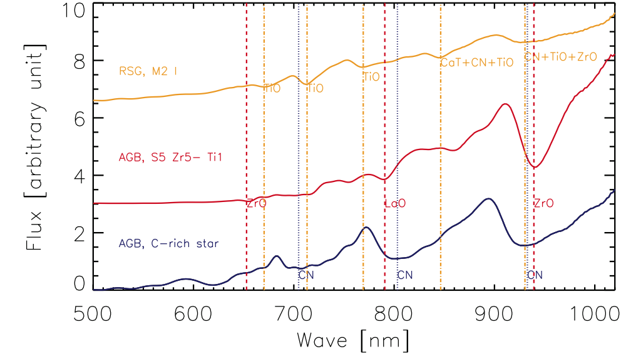
Gaia-DR3 BPRP spectra of AGBs and RSGs
Messineo (2023)
Notes:
Carbon stars can be automatically detected with BP/RP spectral data. There are three strong absorption (dotted blue lines) centred at 704.8 nm, 803.3 nm, and 932.8 nm.
A flag for C-rich is provided by the Gaia DR3 LPV-variable pipeline, we suggest a) to implement a second flag based on the minima, b) a classification based on an empirical BPRP spectral library.
S type stars, SX/(4-8) with X later than 4, display strong ZrO and LaO absorption features and can be uniquely detected with BP/RP spectra. In red the 653nm ZrO line, the LaO line at 790.7 nm, and the ZrO line at 939.3 nm.
RSG – TiO absorption are seen in an M2 type are marked in yellow.

Slide 10
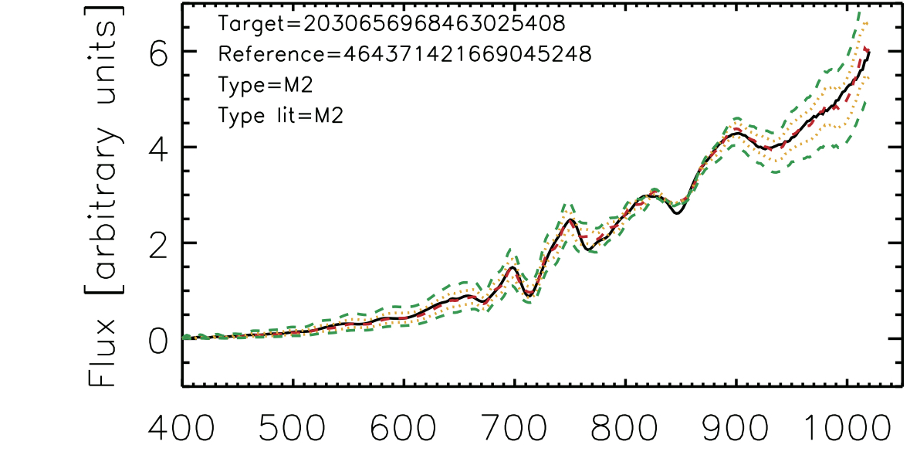
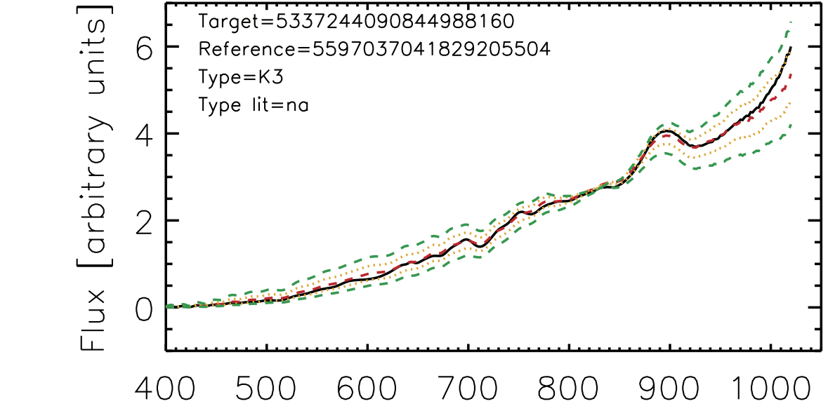
Gaia-DR3 BPRP spectra of cRSGs
The total A_{Ks} is measured with the naked (J-Ks) and (H-Ks) colours of RSGs by Koornneef (1983).
Spectral types are inferred using reference stars, and comparing their Gaia DR3 BPRP spectra.
Notes:
Carbon stars can be automatically detected with BP/RP spectral data. There are three strong absorption (dotted blue lines) centred at 704.8 nm, 803.3 nm, and 932.8 nm.
A flag for C-rich is provided by the Gaia DR3 LPV-variable pipeline, we suggest a) to implement a second flag based on the minima, b) a classification based on an empirical BPRP spectral library.
S type stars, SX/(4-8) with X later than 4, display strong ZrO and LaO absorption features and can be uniquely detected with BP/RP spectra. In red the 653nm ZrO line, the LaO line at 790.7 nm, and the ZrO line at 939.3 nm.
RSG – TiO absorption are seen in an M2 type are marked in yellow.

Slide 11
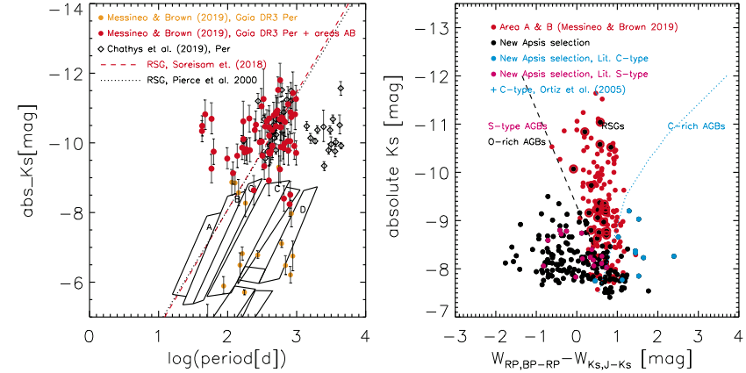
Gaia-DR3 photometric selection of AGBs and RSGs
RSG
Ampl(K) < 0.25 mag
Wood et al. (1983)
Ampl(I)=2.2Ampl(J)
Messineo (2022)
335 new
87/1060
have periods
Ampl(G) < 0.5 mag
Stars are from the catalog of Messineo M., Brown, A. G. A. 2019, Fig. from Messineo (2023)
AGB sequences A, B, C’, C, D are from Riebel et al. (2010)
Color as in Abia et al.
(2023)
Notes:
Period-luminosity diagram of Galactic RSGs in red (messineo19) and diamonds the 50-years monitored stars from Chathys et al (2019) and AAVO.
A fantastic tool to dig out AGBs and RSGs from the Gaia database.
Absolute Mk versus Wrp,bp-rp-Wks,J-ks (extinction free color defined as in Abia 2022).
In the paper I report about 20 new RSGs selected from the APIS parameters and which are located in the RSGs sequences of these two photometric diagrams.
APIS parameters
-0.7 < log g <0.7
Teff < 3800 K (M type)
-0.5 < [Fe/H] < 0.5
Omega/omegasigma >4
203
I can add that, neglecting the APIS parameters, and for example selecting stars from 2MASS or wise
the new candidate RSGs would amount to are xx and 264, respectively. ADDED to the 486 is XX.

